Slide 1
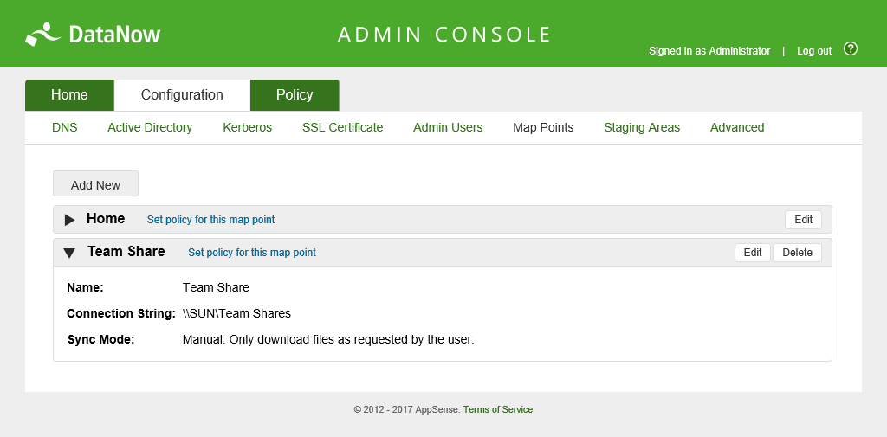
Product Datasheet
AppSense DataNow 4.1
Effortless data migration and secure file sync
Key Features:
Fast and simple file migration for desktop transformation or Windows migrations projects
Eliminate data sprawl by syncing user files from local endpoints to either on-premises storage or Microsoft OneDrive cloud storage
Total file sync coverage including Microsoft Outlook .pst files
Granular sync and access policy control
Secure enterprise file access, sync and sharing from any device including Windows, Mac, iOS, Android and the Web.
Encryption of data both in transit and at rest on mobile devices
AppSense DataNow enables simple, secure file sync and migration of corporate data, no matter where it resides. DataNow is the only file sync and migration solution that delivers a completely native end user experience, without requiring IT to change any existing management or storage infrastructure.
Has your IT department struggled to cope with the burden of ensuring users’ files are accessible during and after desktop transformation projects including:
Operating System upgrades and re-imaging?
Hardware refreshes and desktop migrations?
Hardware replacements and break-fix issues?
Multi-endpoint access requirements such as physical to virtual desktops or shared workstations?
With DataNow, migration of users’ data is a simple, stress-free task that, once initiated, means IT is instantly prepared for any future migration projects. In addition, the file migration and sync process is 100% unobtrusive to your users.
Now, users get secure access to their data irrespective of which device they log on to or how they access their desktops.
Questions on how to handle Data sprawl associated with users saving files to their local devices are now answered, as local files and folders can be effortlessly synced to your on-premises data storage or directly to cloud storage, leveraging your existing investments in Office 365 and OneDrive for Business.
And since DataNow easily integrates with your existing IT infrastructure, there is zero impact on your existing data storage, redundancy, disaster recovery and business continuity plans.
Key Benefits:
Effortless file migration to Windows 10 desktops
Provide desktop that does not need user training
Centrally report on all access
Rapid deployment with no new storage required
Utilise existing backup, disaster recovery and business continuity measures
End-to-end data security and network control
Satisfy data governance and compliance
Future-proof as your storage needs change
About AppSense
AppSense is the leading provider of User Environment Management solutions for the secure endpoint. AppSense technology allows IT to secure and simplify workspace control at scale across physical, virtual and cloud-delivered desktops. AppSense solutions have been deployed by 3,600 enterprises worldwide to 9 million endpoints. AppSense is now part of the LANDESK family with offices around the world. For more information please visit www.appsense.com.

Slide 2
Product Datasheet
AppSense DataNow 4.1
Effortless data migration and secure file sync
Flexible sync options
DataNow is the only file access and migration solution designed to ease the burden on IT departments during Windows migration and desktop transformation projects. It’s granular sync mechanism allows user files to be synced to back-end storage or streamed locally to user desktops either:
In the background
On-demand
In real-time
These elective data sync methods allow users to access files as-and-when they need them without incurring costly storage and bandwidth penalties associated with limited local disk resources or slow network links.
In addition, any file type or file size can be managed and an efficient delta sync mechanism ensures large files, including in-use Outlook PST files, can be synced from the endpoint, sending only the relevant changes made, significantly reducing network traffic and sync time and providing complete endpoint coverage of your users’ data needs.
Ghost files
The sync mechanism included with DataNow enables users to view files held centrally in your datacenter or cloud storage without having to download the files locally first. This introduces huge savings on network usage, particularly for devices being used over limited bandwidth connections, and also allows users to search files whilst offline.
Resumable uploads and downloads for all file types also ensures against data loss in the event of network outages or poor connectivity.
Enterprise ready
DataNow integrates seamlessly with your existing Active Directory for user management and authentication and provides single sign-on, with or without Kerberos Authentication. For large-scale migration projects, DataNow clusters can be configured to distribute load and cater for geo-located users.
Optimized for VDI environments
DataNow’s on-demand access to user data ensures migration from physical to non-persistent VDI desktops can be realized by streaming users’ files to the desktop at logon or on-demand as required.
Granular access policy engine
DataNow respects and enforces file access controls on your existing network storage including NTFS permissions and includes Distributed File System (DFS) support with Access Based Enumeration, so no changes are required to your existing environments.
End-to-end security
DataNow keeps files secure without IT imposing VPN headaches on users. SMB2 and SMB3 support with end-to-end file encryption ensures data is secured in transit.
Find out more
Visit www.appsense.com/DataNow to learn more and request a demo
or email: iwanttoknowmore@appsense.com
Ghost file
Ghost file

